Slide 1
Pandemic Simulation Game High Concept
SMU Guildhall

Slide 2
OVERVIEW
01
02
03
OUR HIGH CONCEPT
SIMULATION ENGINE
DISCUSSION
An overview of the game as we see it.
A review of our simulation plan.
Discuss the work moving forward.

Slide 3
MAIN GOAL
Use the resources at the player’s disposal to identify a pathogen and formulate a response to contain the threat.

Slide 4
ROLE-BASED GAMEPLAY
Each scenario will allow for several different “roles” that players can take on one or more of during the game
Ex. Hospital Director, Head of R&D, Public Relations Manager
Each role will have certain actions they can take each round in order to work towards the goal
Ex. Limiting/expanding hospital capacity, increasing production/distribution of tests, running ad campaigns

Slide 5
LIMITED RESOURCES (PER ROUND)
Each action the player takes will cost a certain amount of resources (time, money, personnel, etc.)
These resources will get replenished at the start of each round
Some actions may affect how many resources the player has
Ex. Increasing hospital capacity may decrease the resources a player has, but will help the recovery rate

Slide 6
EXAMPLE GAME SCENARIO
Scenario: Covid-19 is emerging as a dangerous pathogen, and has only just become known as a threat to the public. The disease has been identified, but no cure or vaccine has been created yet. The task is to formulate a plan to contain the pathogen, while still keeping the public calm and informed.
Hospital Director Head of R&D Public Relations Manager
Actions: Hospital Capacity, Sanitation Mandates
Affects: Hospital recovery rate, transmission, and capacity
Actions: Vaccine Development,
Test production and distribution
Affects: Testing and severity of pathogen, false positive/negative rate
Actions: Ad campaigns, encouraging masks/social distancing,
Affects: transmission rate out of hospital, public perception

Slide 7
MODIFIERS/GAME CONTROL
Info-cards
Random events
Can be generated by AI or manually by someone facilitating the game
Game can be run either with or without a facilitator
Without: game can generate random events and modifiers to the scenario, and an AI will handle player responses and inputs
With: the facilitator can pause the game and modify values at any time to add variation to the scenario, or to encourage specific teaching moments

Slide 8
TRAINING/TEACHING MOMENTS
Once certain milestones in the game are met (good or bad), the game can offer teachable moments based on the player’s decisions
Ex. “You’ve filled 80% of your country’s hospitals within 3 months! Here are the choices that led to that outcome, and how it might be avoided”

Slide 9
TRACKING DATA
Each scenario/role will track the choices made by the players and convert it into readable data both during the game and in retrospective.

Slide 10
MODULARITY IN MIND
Roles and scenarios are designed to be added and removed from the game at will, so each simulation can be fully customized to whatever level of specificity is desired
Each model will have a base simulation that can be run without input to get the same results every time
Ideally, multiple scenarios and simulations would eventually be able to all run simultaneously so the effects of a choice within one scenario could be seen in a completely different one
This game is just one that could potentially be made by using the model/roles system, since it is almost entirely data driven

Slide 11
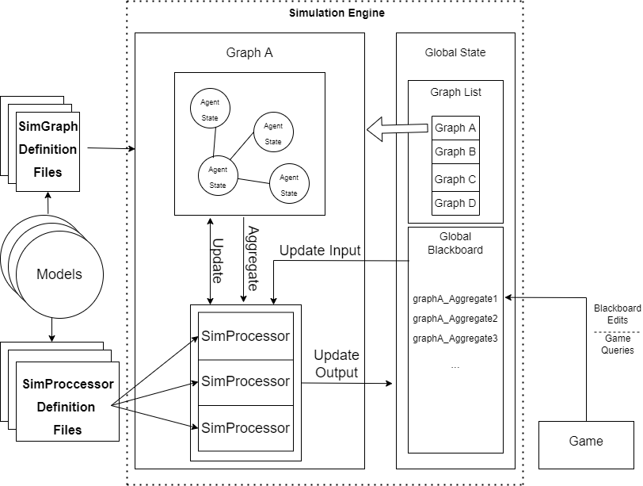
SIMULATION ENGINE FEATURES
A dynamic, real-time method for querying and affecting the simulation of scientifically based models:
100% data driven
Platform agnostic code library
Extendable and Scalable
Queryable in game
Adapts to real-time game inputs
Simulates complex real-world relationships and networks

Slide 12
QUESTIONS?
Thank you!

